Slide 1
INTERLESS: Interference-Aware Deep Resource Prediction for Serverless Computing
Ruifeng Ma, Yufeng Zhan, Tijin Yan, Yuanqing Xia∗, and Yasir Ali
School of Automation, Beijing Institute of Technology
Notes:
Hello everyone. My name is Ruifeng Ma. We are from the School of Automation, Beijing Institute of Technology. The topic of my talk is INTERLESS: Interference-Aware Deep Resource Prediction for Serverless Computing.

Slide 2
Contents
Background and motivation
INTERLESS Design
Performance Evaluation
Future Work

Slide 3
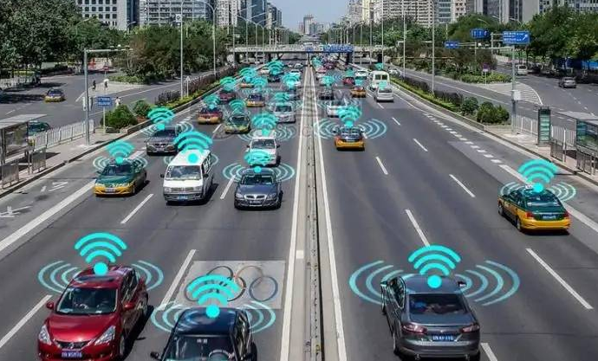
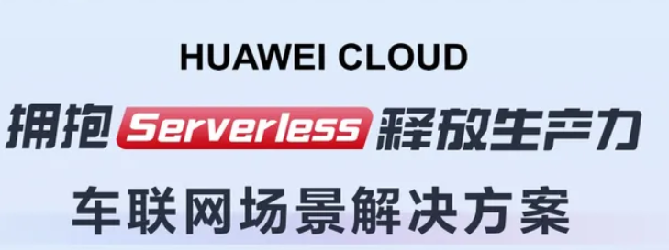
Serverless: Autoscaling for Dynamic Requests Load
Scenarios: Dynamic Requests Load
Scenario 1: Online services (ML inference, Web, etc.)
Scenario 2: Dynamic traffic and connected vehicles
Low Resource Efficiency:
Dynamic request load is difficult for resource allocation.
In 2017, the CPU utilization of the Alibaba cluster was 39.26%.
Serverless: Application Auto Scaling
Manager
Manager
Serverless Function
Add 0.5CPU，1G MEM
Add 0.5CPU，1G MEM
Serverless Function
1 CPU, 2G MEM
1 CPU, 2G MEM
1.5 CPU, 3G MEM
1.5 CPU, 3G MEM
Instance 1
Instance 2
Instance 1
Instance 2
New users
Notes:
The requests of cloud service changes dynamically. For example, for online services like ML inference and web service, as shown in this image, during in the daytime, more users use this service, but during the mid-night, the requests are relatively less. So it changes every day. For connected vehicles, the amount of requests also changes dynamically with the everyday traffic flows. During the 8 am or 7 pm, more cars are connected to this service. But during the midnight, less cars are use this service.
Cloud user tend to ensure the quality of service. They allocate the resource as the highest request load. It lead to low resource efficiency. For example, in 2017, the CPU usage of the Alibaba cluster was very low.
Serverless is an emerging cloud paradigm that enables developers without managing cloud resources. Serverless can auto scale resource to support dynamic request load. It can allocate more resource during the high request load. And allocate less request for the low request load.
However, the challenge for managing resource is moved to cloud provider. And managing resource is difficult.

Slide 4
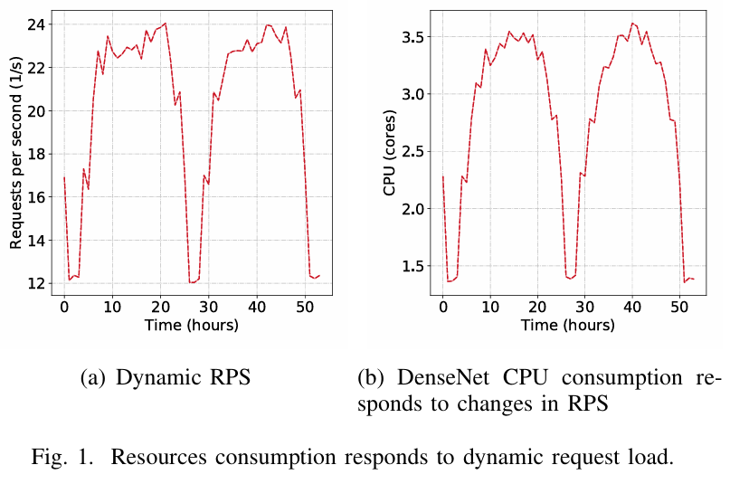
Prediction Helps Warm-up Serverless Functions
Cold start refers to the time required to prepare the execution environment.
Compared to virtual machines, serverless greatly reduce cold start time. But the preparation (e.g., initialization and resource updates), which take longer than the execution time.
A 100 ms service level objective (SLO) violation resulted in a $700 million loss for Amazon in 2018 Q4.
Predicting future resources helps make decisions about warming-up functions to mitigate cold start and SLO violation.
Notes:
Resource prediction is necessary in serverless. As shown in Figure 1, the CPU of DenseNet function changes corresponding to the dynamic workload. Therefore, cloud providers must estimate the resources and auto-scale function instances to support dynamic workloads.
Moreover, the cold start is the time to prepare the execution environment for serverless functions. As shown in Table I, the operations for preparing the execution environment (for example, initialization and resource update) take longer time than the function execution. It significantly increases the response time. A 100 millisecond SLO violation resulted in a $700 million loss for Amazon. Predicting future resources helps make decisions about warming-up functions to mitigate cold start and SLO violation .

Slide 5
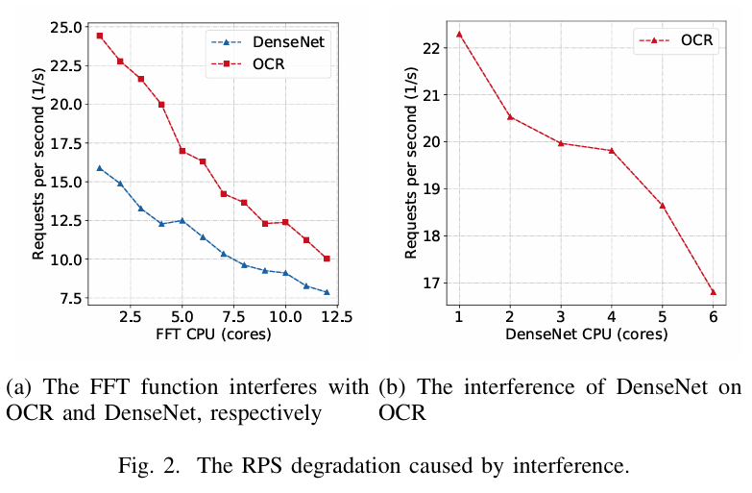
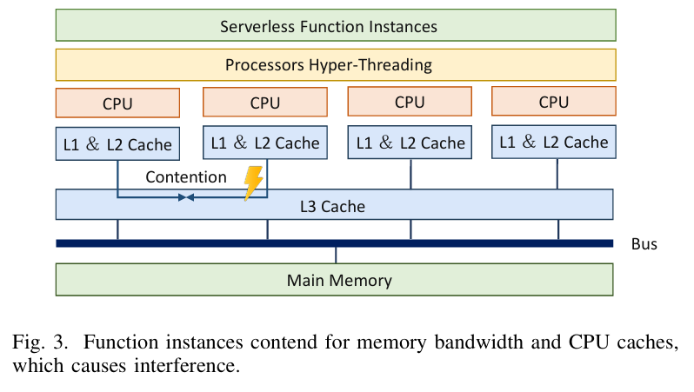
Challenge: Interference between Function Instances
Interference introduce combinations between functions, making predicting resources difficult.
Shared resources (e.g., memory bandwidth and caches) contentions cause interference.
Notes:
The interference among co-located functions makes predicting resources difficult. Figure 2(a) illustrates how the FFT function interferes with OCR and DenseNet, respectively. As the CPU usage for FFT increases, the performance of both OCR and DenseNet decreases, with the performance of DenseNet decreasing by more than 58%. Figure 2(b) shows the interference of DenseNet on OCR. As the CPU usage of DenseNet increases, the performance of OCR decreases. The combination of interference makes prediction difficult.
The factor that causes interference is shared resources contention. Processes on multiple CPU cores still compete for shared resources, such as memory bandwidth and caches. Figure 3 shows the architecture of Non-uniform Memory Access, where function instances compete for memory bandwidth and caches. While Linux containers can allocate CPU cores and memory for function instances, they encounter limitations in segregating shared resources. However, the Linux Kernel’s isolation of shared resources relies on tools like Intel RDT. Those tools only support a limited number of CPU models and cannot isolate other shared resources such as L1 and L2 cache. This limits the scope of use.

Slide 6
Related Works
Most of deep learning based resource predictors [1],[2],[3] fail to model the placement and interference between function instances.
Very few studies [4] have considered the impact of interference on performance prediction, but they only support CPU as the resource type.
Other works [5],[6] try to isolate shared resources to eliminate interference.
Isolation tools (Intel RDT) only support a limited number of CPU models and cannot isolate other shared resources such as L1 and L2 cache. This limits their application scopes.
Therefore, interference between function instances remains an unsolved problem for resource prediction.
[1] The power of prediction: Microservice auto scaling via workload learning, Socc 2021, CCF-B
[2] Pert-gnn: Latency prediction for microservice-based cloud-native applications via graph neural networks, SIGKDD 2023, CCF-A
[3] Deeprest: Deep resource estimation for interactive microservices, Eurosys 2022, CCF-A
[4] Iris: Interference and resource aware predictive orchestration for ml inference serving, IEEE Cloud 2023
[5] FIRM: an intelligent fine-grained resource management framework for slo-oriented microservices, OSDI 2020, CCF-A
[6] PARTIES: qos-aware resource partitioning for multiple interactive services, ASPLOS 2019, CCF-A
Notes:
The interference among co-located functions makes predicting resources difficult. Figure 2(a) illustrates how the FFT function interferes with OCR and DenseNet, respectively. As the CPU usage for FFT increases, the performance of both OCR and DenseNet decreases, with the performance of DenseNet decreasing by more than 58%. Figure 2(b) shows the interference of DenseNet on OCR. As the CPU usage of DenseNet increases, the performance of OCR decreases. The combination of interference makes prediction difficult.
The factor that causes interference is shared resources contention. Processes on multiple CPU cores still compete for shared resources, such as memory bandwidth and caches. Figure 3 shows the architecture of Non-uniform Memory Access, where function instances compete for memory bandwidth and caches. While Linux containers can allocate CPU cores and memory for function instances, they encounter limitations in segregating shared resources. However, the Linux Kernel’s isolation of shared resources relies on tools like Intel RDT. Those tools only support a limited number of CPU models and cannot isolate other shared resources such as L1 and L2 cache. This limits the scope of use.

Slide 7
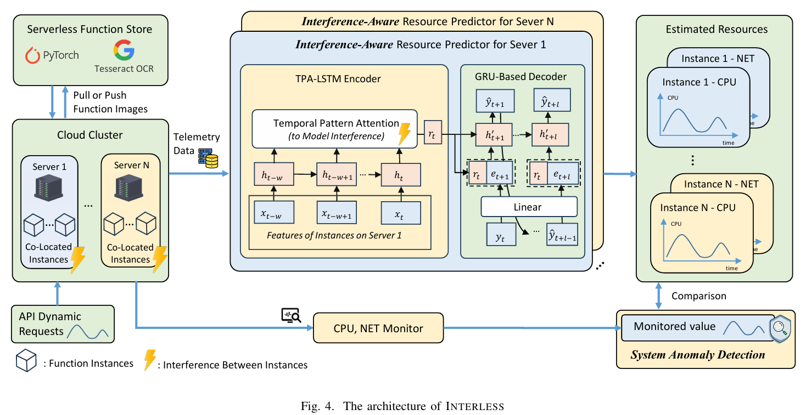
The Architecture of INTERLESS
System Manager: Implemented at the top of the Docker Swarm cluster to maintain the function store, monitor metrics and manage resources.
Resource Predictor: The attention-based network for modeling the interference between functions.
System Anomaly Detection: By comparing monitored and predicted resource consumption.
Notes:
The architecture of INTERLESS includes Serveless Platform, Resource Predictor, and System Anomaly Detection. The system manager is implemented at the top of the Docker Swarm cluster to maintain the function store, load balance requests, monitor metrics and manage resources.
The interference-aware deep resource predictor applies a sequence-to-sequence architecture with an attention-based network for modeling the interference between functions.
In addition, INTERLESS can also identify system anomalies by evaluating whether the resource consumption is consistent with the function’s intended consumption, making it effective against crypto-mining attacks.

Slide 8
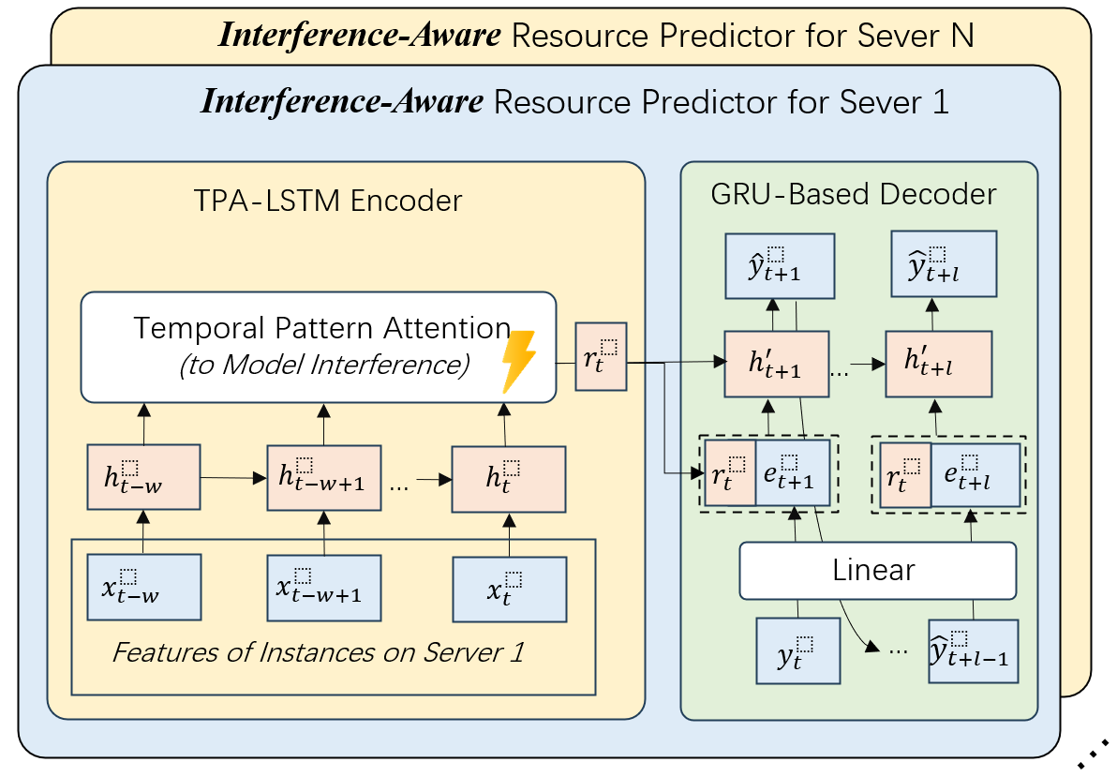
Resource Predictor
Sequence-to-sequence architecture
The attention-based network only to model the interference between instances within each server.
Builds an independent interference-aware deep resource predictor on each server to reduce the computational burden for extensive combinations
Features: instance’s requests per second (RPS) and the concurrency of requests
Notes:
The predictor applies a sequence-to-sequence architecture with an attention-based network for modeling the interference between functions.
However, modern serverless systems operate thousands of function instances. Analyzing the interference among many instances necessitates extensive combinations and computational burden. The interference between functions takes place within the same physical server. Therefore, INTERLESS applies the attention-based neural network only to model the interference between instances within each server. INTERLESS builds an independent interference-aware deep resource predictor on each server to reduce the computational burden for extensive combinations.
The input to the interference aware deep resource predictor is the historical all-instance request features, including the instance’s RPS and the concurrency of requests.

Slide 9
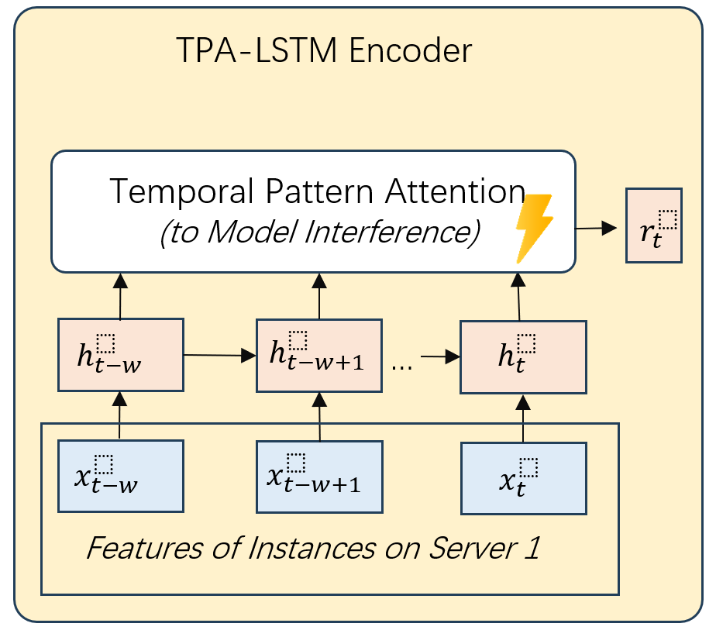
Interference-Aware Encoder
Purpose and Solution
Purpose 1:
Prior requests queuing
Solution 1: Long short-term memory (LSTM) to characterize past request queuing as a time series
Purpose 2: Modeling the interference between function instances
Solution 2: The hidden state of LSTM is fed into Temporal Pattern Attention
Notes:
The predictor’s encoder has two goals. First, it can characterize past requests. Resource consumption at the present time step depends not only on the current requests but also on prior events due to potential queuing effects. Second, the interference between function instances can be effectively modeled by the attention-based neural network.
To address the two goals, INTERLESS uses long short-term memory (LSTM) to characterize past request queuing as a time series, which has a recurrent structure to allow information propagation over time. The hidden state of LSTM is fed into Temporal Pattern Attention (TPA) to model the interference between function instances.

Slide 10
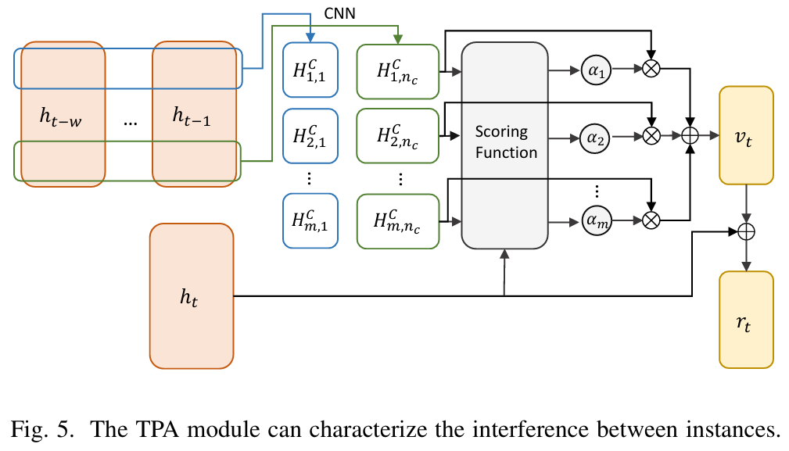
Temporal Pattern Attention
Temporal Pattern Attention: The weighted sum of hidden vector from different time series dimensions.
Convolves Hidden States by 1-D CNNs: $H_{i,j}^{C}=\sum_{l=1}^{w}{ }H_{i,(t−w−1+l)}×C_{j,T−w+l}$.
The Scoring Function: $f(H_{i}^{C},h_{t})=(H_{i}^{C})^{⊤}W_{a}h_{t}$.
Attention weight: $α_{i}=\text{sigmoid}(f(H_{i}^{C},h_{t}))$.
Weighted Sum: $v_{t}=\sum_{i=1}^{2n_{i}}{ }α_{i}H_{i}^{C}.$
Notes:
The hidden state of LSTM is fed into Temporal Pattern Attention to model the interference between function instances. The Temporal Pattern Attention is the weighted sum of hidden vector from different time series dimensions.
h_t represents the hidden state of the RNN at time step t. There are 1-D CNN filters, shown as different colors of rectangles. Then, each filter convolves over features of hidden states and produces a matrix H^C by the following equation.
The scoring function to evaluate relevance is as follows. Then, the attention weight alpha is obtained as $\text{sigmoid}$ calculation. Completing the process, the row vectors of H_C are weighted by alpha to obtain the context vector v_t. Then we integrate v_t and h_t as the state r_t.

Slide 11
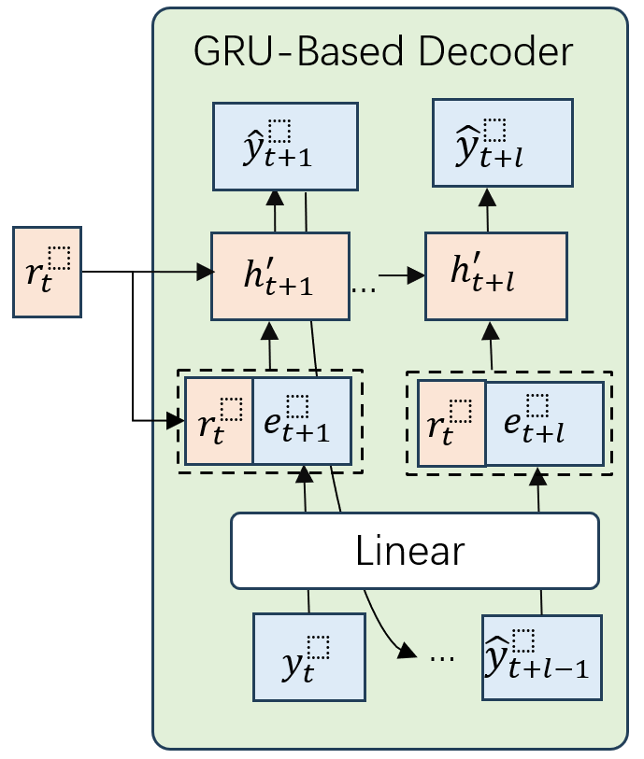
Decoder for Longer Horizon
Purpose and Solution
Purpose 1: Predict long and variable length time series
Solution 1: GRU for long-horizon resource prediction
Purpose 2: effectively process the TPA-encoded feature $r_{t}$.
Solution 2: Initialize the GRU’s hidden state with $r_{t}$. Join the $e_{t+1}$ and $r_{t}$as the input of GRU.
Notes:
The predictor’s decoder serves two purposes. First, it must predict long and variable length time series for function scheduling, resource configuration, and anomaly detection. But predicting long time series is challenging. Second, it should effectively process the TPA-encoded feature r_t.
To achieve the first purpose, INTERLESS’s decoder includes a GRU for long-horizon resource prediction. The GRU has superior performance for predicting long and variable length time series than conventional multi-layer perceptrons.
To achieve the second purpose, INTERLESS initialises the GRU’s hidden state h^prime_{t+1} equal to r_t. Then INTERLESS joins the embedding e_{t+1} and state r_t as the input of GRU.

Slide 12
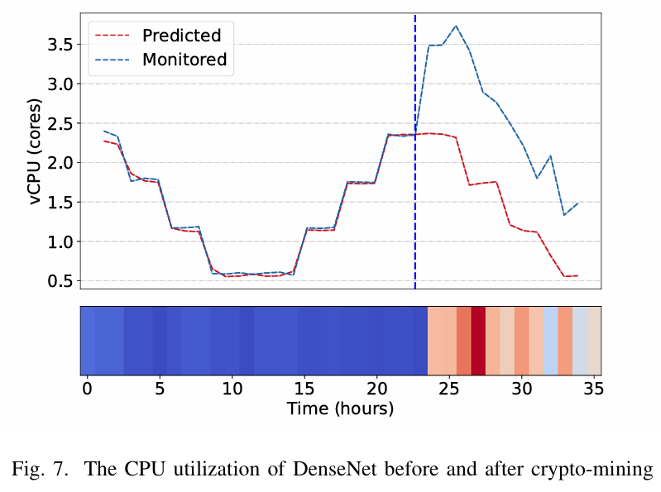
System Anomaly Detection
INTERLESS detects and alerts system anomalies attacks by comparing monitored and predicted resource consumption
Still, abnormal resource usage may also be caused by software bugs
To alert to system anomalies, INTERLESS generates the interpretable alert logs
Figure 7 shows the crypto-mining attack simulated by stress-ng's fast fourier transform (FFT) calculation
Notes:
INTERLESS detects and alerts system anomalies such as crypto-jacking attacks by comparing monitored and predicted resource consumption. Still, Abnormal resource usage may also be caused by an increase in the number of users or software errors (for example, memory leaks). To alert to system anomalies, INTERLESS generates the interpretable alert logs, including features such as the instance’s RPS and the concurrency of requests sent to the cloud provider.
We simulate a crypto-mining attack by installing a process in the stress-ng to steal the resources for FFT calculation. Figure 7 shows the CPU utilization of the DenseNet, where the crypto-mining began on the 23rd hour. The actual measurements is the blue curve. It indicate an increased CPU utilization. INTERLESS detects crypto-mining attacks by comparing monitored resource consumption with the resources predicted for normal system operation. To alert the system anomalies, INTERLESS generates the interpretable alert logs, including features such as the instance’s Request Per Second and the concurrency of requests to be sent to the cloud provider.

Slide 13
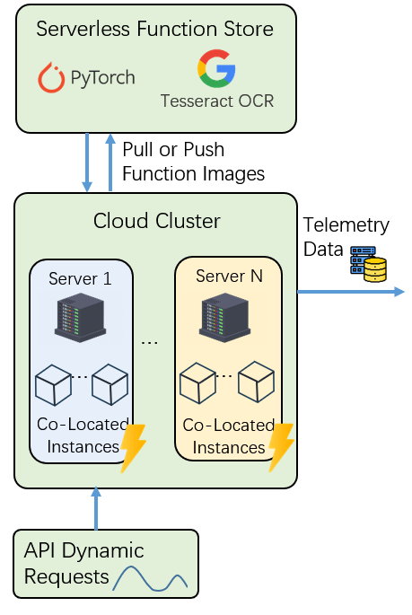
Dataset and Experimental Settings
Dataset
We deploy serverless functions in a cluster and ensure their performance meets our service level objective despite fluctuating web views.
Cluster data collected for 1 minute equates to 1 hour in real-world scenarios. We gather request features and resource usage (CPU, network) for 18 hours, corresponding to 46 days in real-time.
Experimental Settings
Compared methods: Transformer, TPA-LSTM, MQ-RNN.
Evaluated functions: DenseNet inference, Tesseract OCR.
Evaluation metrics: mean absolute percentage error (MAPE), relative squared error (RSE), and symmetric mean absolute percentage error (SMAPE).
Notes:
We deploy the above serverless functions in the cluster. The number of views of modern web applications changes periodically daily, while the performance of the functions always meets the preset service level objective. We collect one minute in the cluster to correspond to one hour of data in the real world. We collect the request features and resource consumption (CPU and network bandwidth) for 18 hours, corresponding to 46 days in the real world.
We compare our method with three state-of-the-arts, including Transformer, TPA-LSTM, and MQ-RNN. Transformer shows great performance in modeling sequence data including time series. TPA-LSTM is a deep learning-based time series predictor which can model the relevant time series. MQ-RNN is a deep neural network for multi-horizon forecasting. MQ-RNN can output quantile prediction. We use P50 quantile prediction as the predicted result.
Two popular functions are used for evaluation. The DenseNet is a neural network for image recognition, which is implemented by Pytorch TorchVision for inference. The OCR defines the process of mechanically converting scanned text images. It is implemented by Tesseract. Tesseract, from 2006 until 2018, was developed by Google. The Evaluation metrics includes mean absolute percentage error, MAPE, relative squared error, RSE, and symmetric mean absolute percentage error, SMAPE.

Slide 14
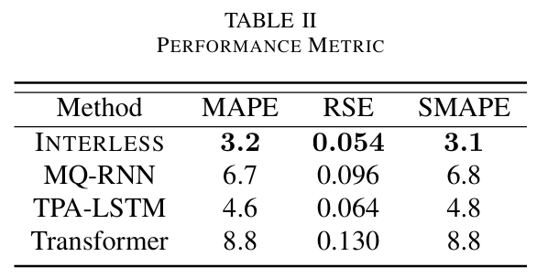
INTERLESS’s effectiveness
In Figure 6(b), the Transformer underestimates the CPU consumption of DenseNet because it ignores the interference.
As shown in Table II, INTERLESS reduces the MAPE, RSE, and SMAPE of prediction by 64%, 58%, and 65% respectively, compared to the state-of-the-arts.
Notes:
Here is the experiment result. It show the effectiveness of INTERLESS. In Figure 6(b), the Transformer underestimates the CPU consumption of DenseNet because it ignores the interference. As shown in Table II, INTERLESS reduces the MAPE, RSE, and SMAPE of prediction by 64%, 58%, and 65% respectively, compared to the state-of-the-arts.

Slide 15
INTERLESS’s effectiveness
In Figure 6(e), MQ-RNN can not capture the interference between functions and tends to underestimate the CPU consumption of OCR.
INTERLESS reduces the SMAPE by 35% compared to TPA-LSTM for predicting 36 hours resources. It outperforms TPA-LSTM for longer time horizons by GRU and sequence-to-sequence architecture.
Notes:
As shown in Figure 6(e), MQ-RNN can not capture the interference between functions and tends to underestimate the CPU consumption of OCR. With the sequence-to-sequence architecture, as shown in Table II, INTERLESS can reduce the SMAPE by 35% TPA LSTM for predicting 36 hours resources. Compared to a traditional multi-layer perceptron, it demonstrates superior per formance for longer time horizons with an INTERLESS GRU based decoder.

Slide 16
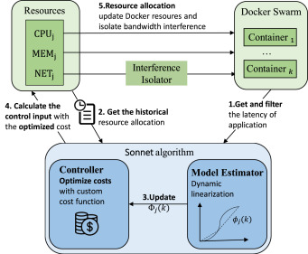
Future Work: A Control Theoretical View of Cloud Elasticity
Feedback Perspective
Problems in Resource Allocation
Resource
Quality of service
Problem: Delay caused by cold start
Control Perspective: Time Delay Compensators
Serverless Function
Controller
Problem: Interference between functions
Control Perspective: External Disturbance
Sonnet[1]:
Quickly allocate resources for new applications using model-free adaptive control
Problem: Resource cost optimization
Control theoretical view : Optimal Control
[1] Ruifeng Ma, Yufeng Zhan*, Yuanqing Xia*, et. al., Sonnet: A Control-Theoretic Approach for Resource Allocation in Cluster Management, Future Generation Computer Systems, 2024 (SCI, IF=7.5, JCR Q1)
Notes:
In the future, cloud resource allocation can be modelled as a control system with a feedback perspective. The control objective is the quality of service for the serverless function. The system input is the amount of resource allocation. Our previous paper Sonnet designed a control-theoretic approach for resource allocation in cluster management. It can quickly allocate resources for new applications using model-free adaptive control.
In the future, some other problems in cloud resource allocation can be addressed by control theory. For example, the delay caused by instance initialization can be addressed by time delay compensators. The interference between function instances can be regarded as external disturbance. The resource cost optimization can be addressed by optimal control.

Slide 17
Thank you!
Ruifeng Ma
www.ppeak.site
ppeak@foxmail.com
Notes:
Thank you for your time and attention. I am welcome to cooperation and this is my website and email address. Please feel free to ask any questions about my presentation.

